Slide 1
Stylish
Less your time, make you happy

Slide 2
Objectives
The objectives of this project are to….
Hair Saloons near me.
Nail Saloons near me.
Spa place near me.
Massage near me.
Barber shops near me.
Tattoo shops near me.

Slide 3
Scope
The area of our project is users and barbers/beauticians.

Slide 4
Methodology
In this project we use waterfall model

Slide 5
Software Used
IDE: Android Studio
Language: Java.
Platform: As this app will be an online app so we will use Firebase Cloud.
Database: Firebase Cloud Firestore.
Srorage: Firebase Cloud Storage.
Other software: JDK.
Android version: This app will run above API 19: Android 4.4 (Kitkat).

Slide 6
Features
Sign up and verification system
Login system
Area wise saloon, parlour, tattoo shop, nail saloon
Online appointment

Slide 7
Cost
Item | Cost
Uploading cost at play store | $25
Total | Around 2200tk/=

Slide 8
Future plan
This project is our start-up plan. We have a business plan behind developing this project. We think this project/app will help the people positively. This will be a very user-friendly app and all sections of people will easily use this app. In future, we will work on cross platform namely “Flutter” then, we will publish this app in “App Store” and update the app by adding new features.

Slide 10
Work Distribution
Work | Name
Sign in with Gmail,Google | Duke
Register | Mahedi
Firebase cloud fire store and cloud storage | Muktadir
Card View | Duke
Filterable Recycle view | Muktadir
Appointment System | Mahedi
Google Map Api and Logout | Muktadir

Slide 11

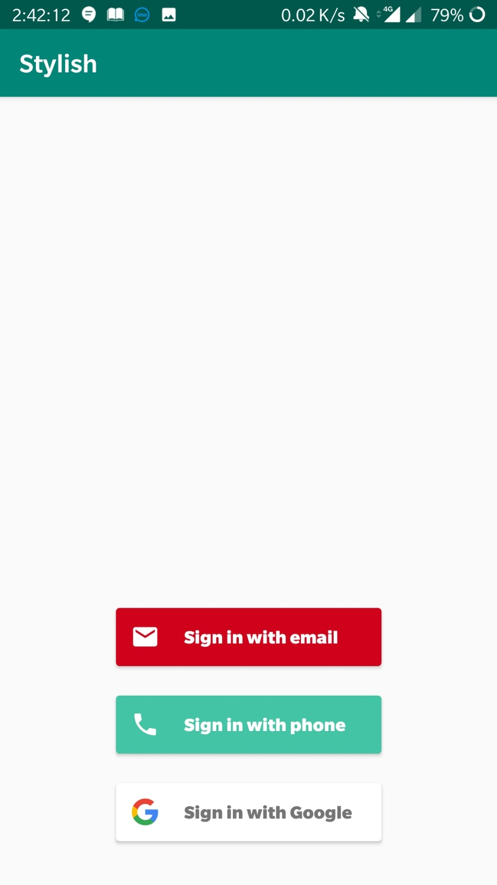
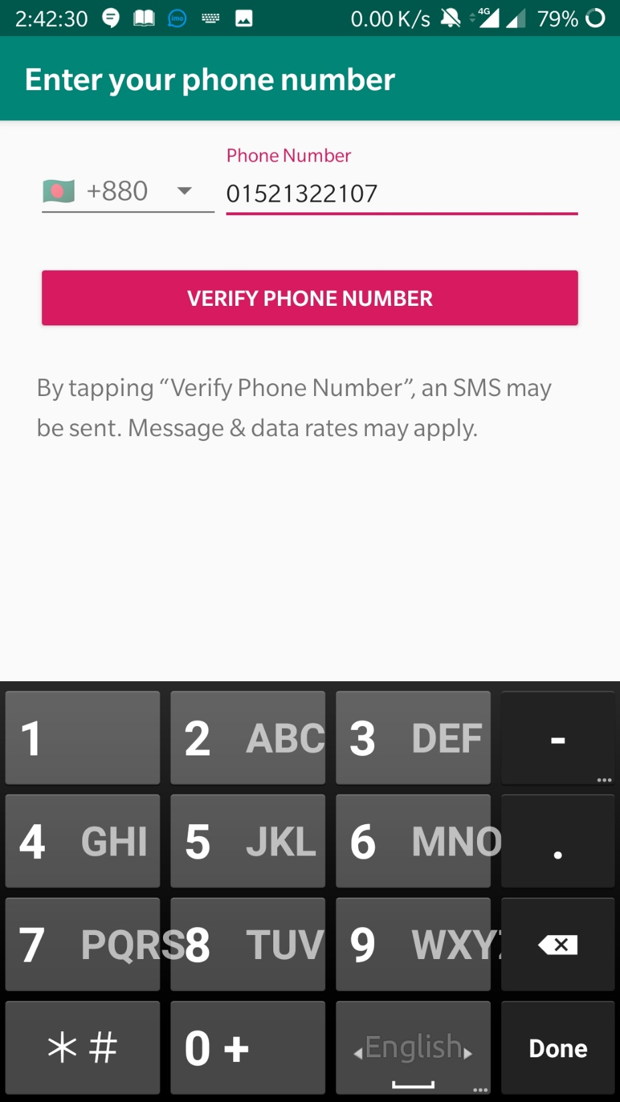

Slide 12
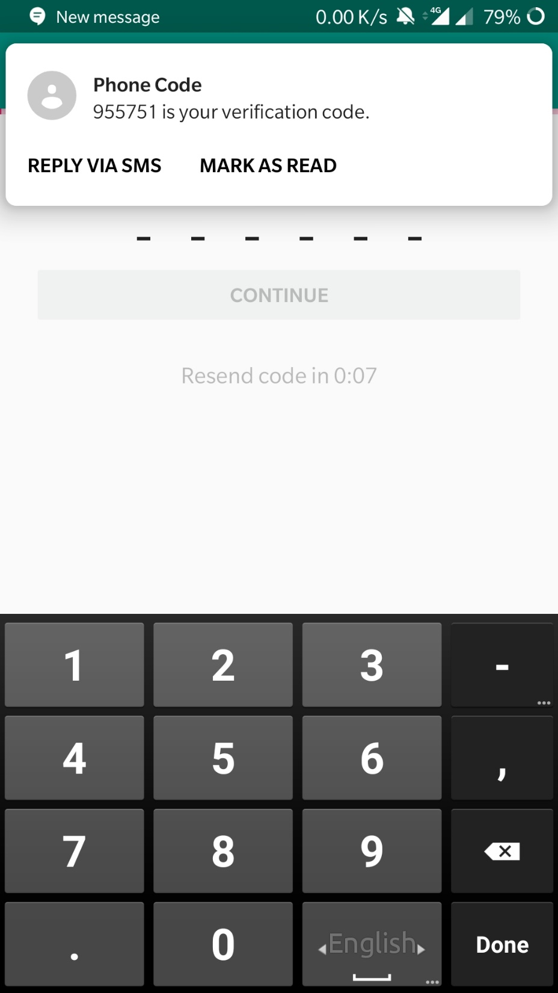
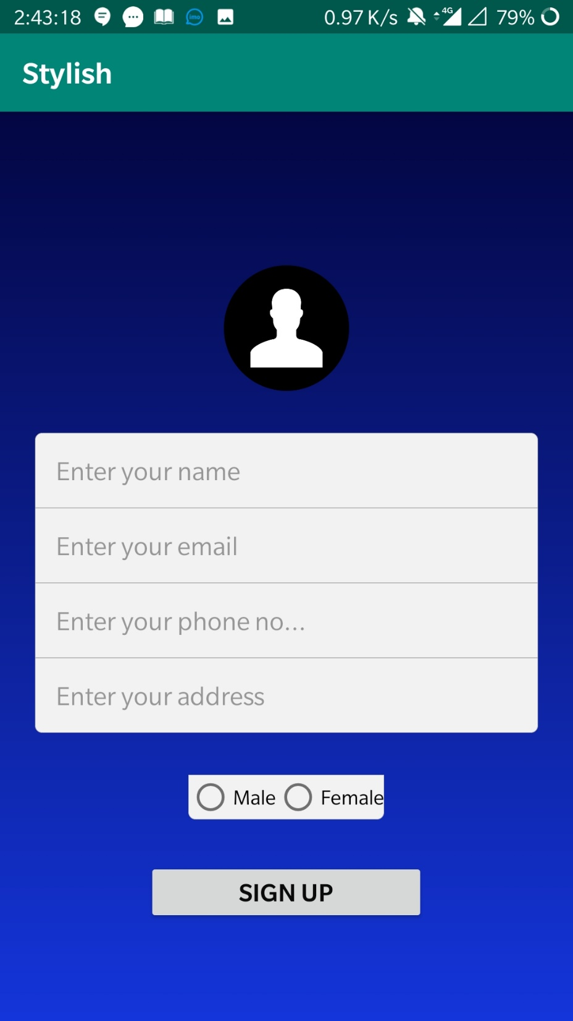
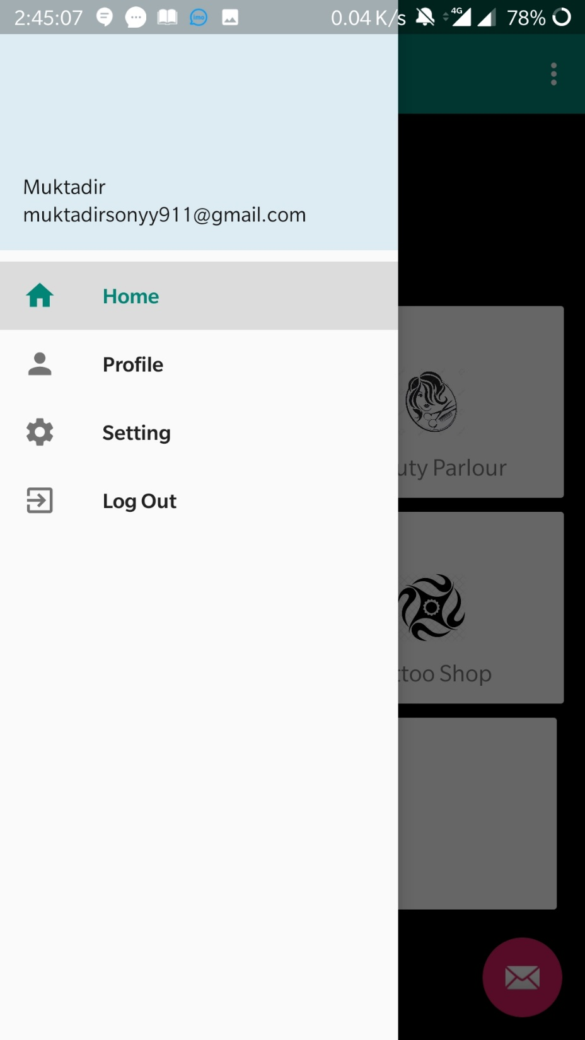

Slide 13
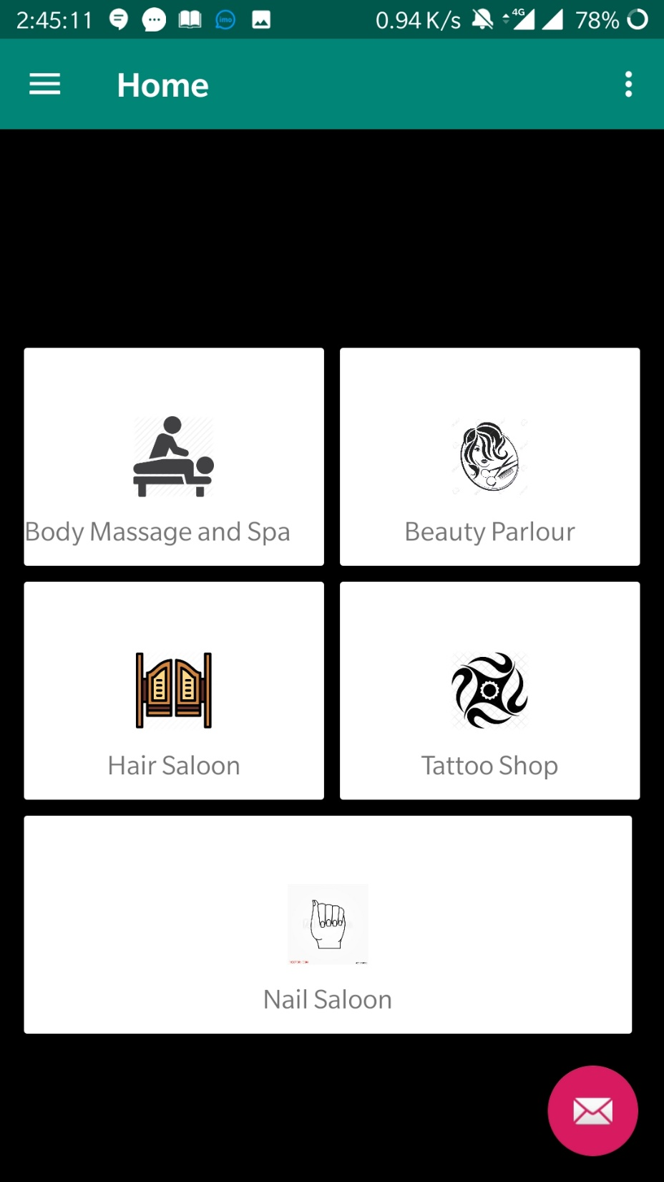
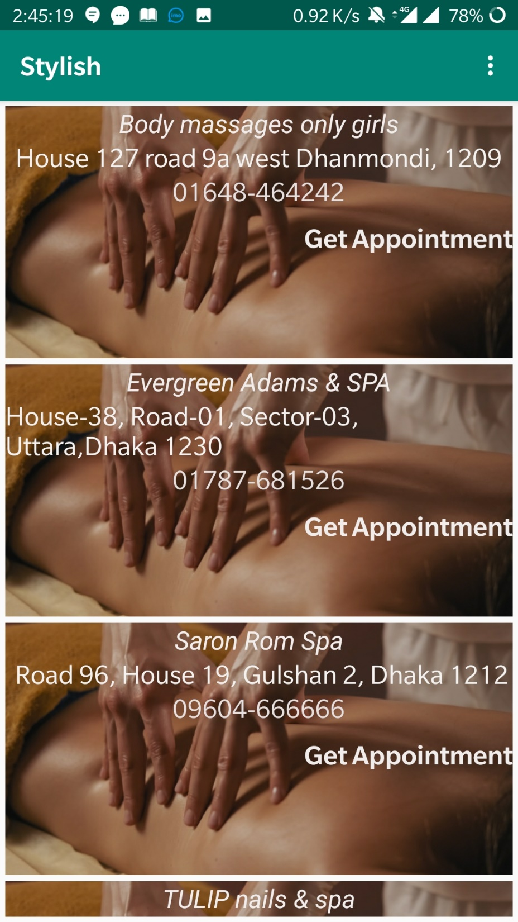
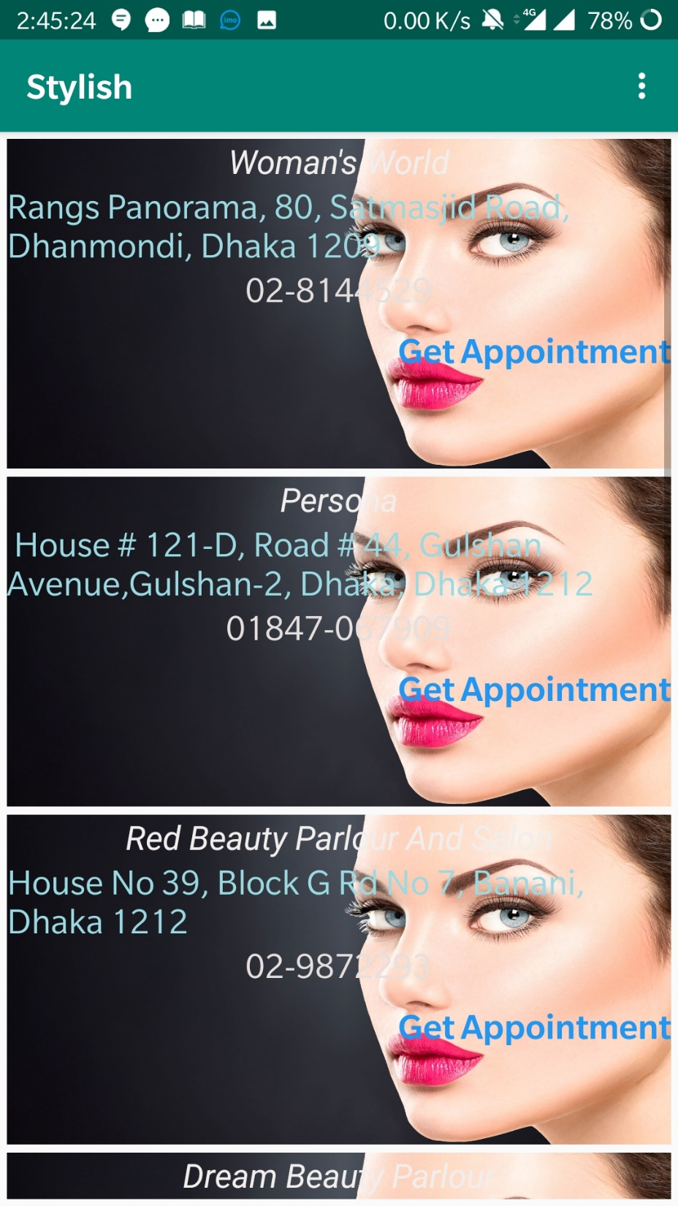

Slide 14
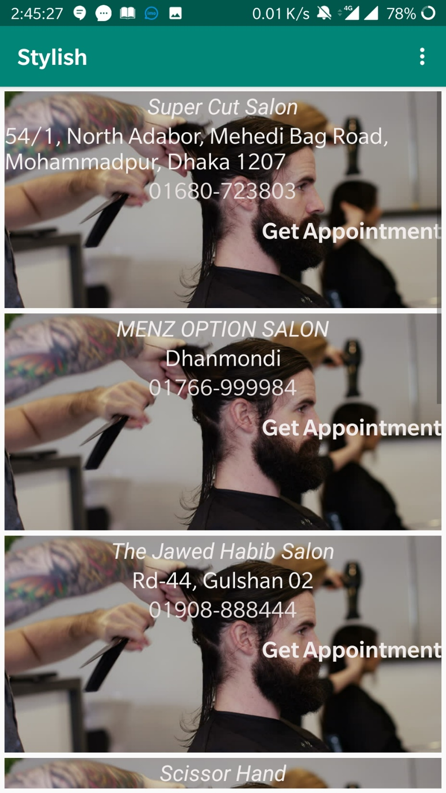
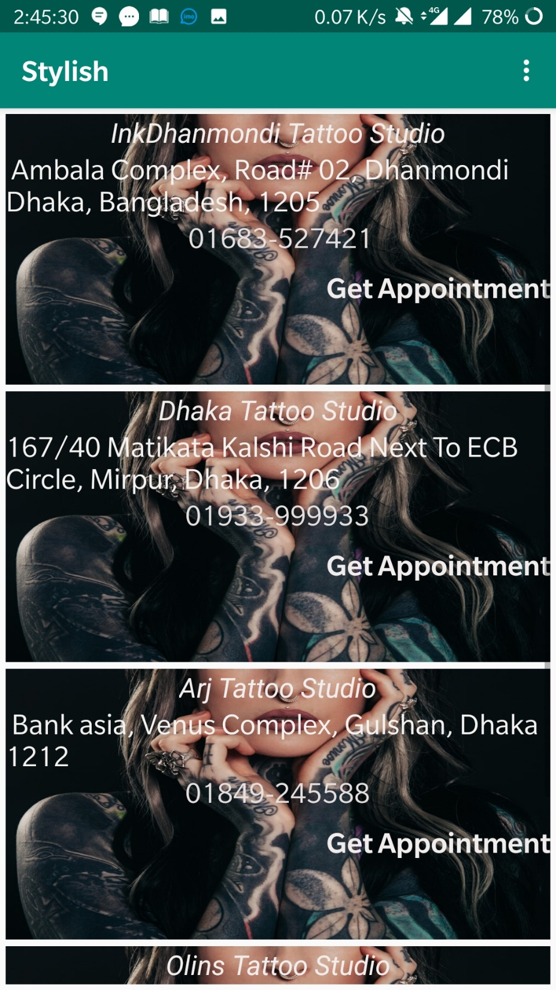
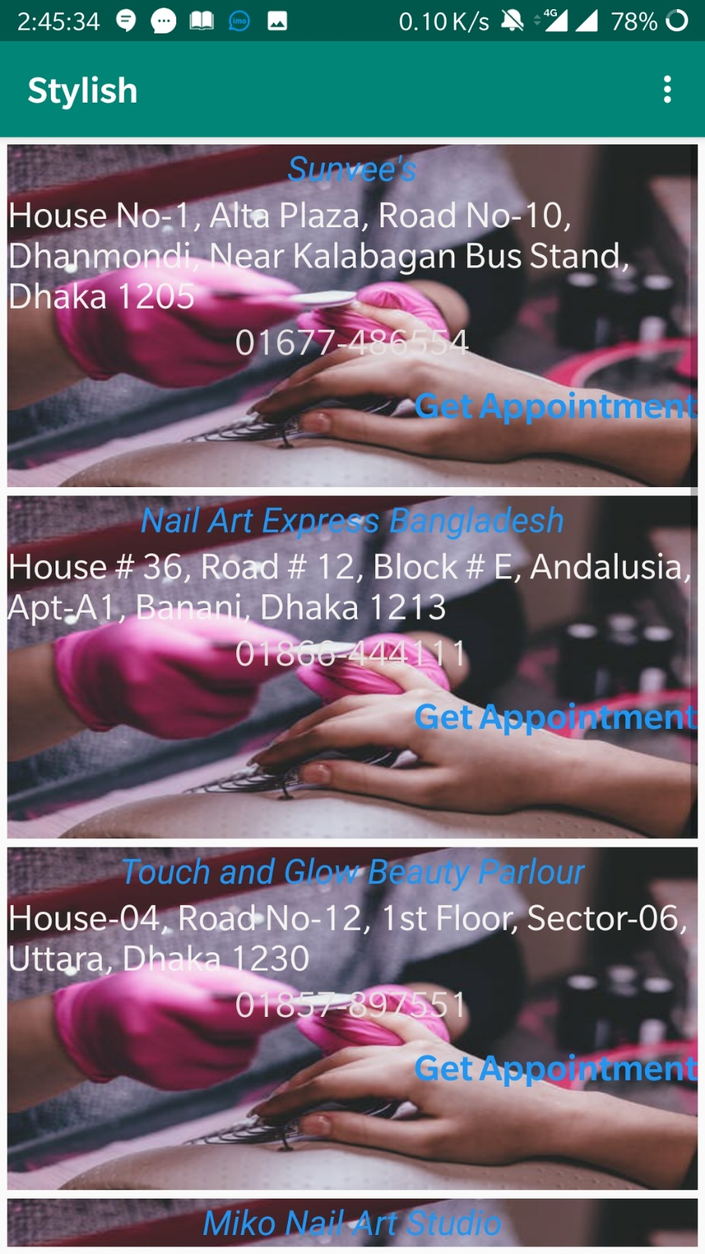

Slide 15
